Slide 1

Data analysis Graduation Final project

Slide 2


Job scope
Data Analysis

Slide 3






Supervisor
student project
Bishoy Victor Nabil
+201068571301
linkedin
Amgad Abdelhamid Hamza
+201154982529
linkedin
Ayman saadan Alkot
+201226181877
linkedin
Bassem
+201220283963
Dr . Amal Mahmoud
linkedin
Ebram Effat Abdullah
+201283336721
linkedin

Slide 4
Introduction
The technology sector in Egypt has been experiencing significant growth, with increasing demand for skilled professionals across various roles. As the job market evolves, understanding compensation trends and the factors influencing salaries becomes crucial for job seekers, employers, and decision-makers. The "Job Scope" project was initiated to provide a data-driven analysis of compensation and job roles in the Egyptian technology sector, leveraging data scraped from a popular job website.

Slide 5
Tools
Python
SQL
Excel
Tableau
R

Slide 6
Objective of the Project:
The primary objective of the "Job Scope" project is to analyze compensation trends and job market dynamics within the Egyptian technology sector.
By leveraging data scraped from a leading website on the Egyptian job market, this project seeks to uncover insights about compensation patterns, job roles, industry focus, and diversity in the tech industry.
Our analysis aims to assist stakeholders—such as job seekers, employers, and policymakers—by providing a clearer understanding of the factors influencing salaries and job opportunities in Egypt’s tech landscape.

Slide 7
1. Compensation Analysis:
What is the average compensation by business market, business size, or industry?
Are there observable patterns in compensation based on years of experience (YOE), job title, or education level?
How do compensation ranges vary by location or work setting (remote, hybrid, in-office)?

Slide 8
2. Job Role and Market Insights
What are the most common job titles across business markets and industries?
How does business focus (e.g., software, finance, etc.) influence job roles or programming languages used?

Slide 9
3. Diversity and Inclusion:
Is there any gender pay gap within different business markets, industries, or job titles?
How does gender representation vary across job titles, business lines, or company sizes?

Slide 10
4. Experience and Education:
Does having a degree affect compensation or career level progression?
How does compensation grow with years of experience across different job roles or industries?
Insight: Analyzing how education and experience impact career progression offers guidance for professionals looking to maximize their earning potential.

Slide 11
5. Geographical Insights:
What are the trends in compensation by company location?
Are there regional differences in business focus or types of roles hired?

Slide 12
6. Work Setting and Flexibility:
How does work setting (remote, hybrid, in-office) impact compensation, job titles, or business focus?
What are the trends in work settings across different industries or business sizes?

Slide 13
Python

Slide 14
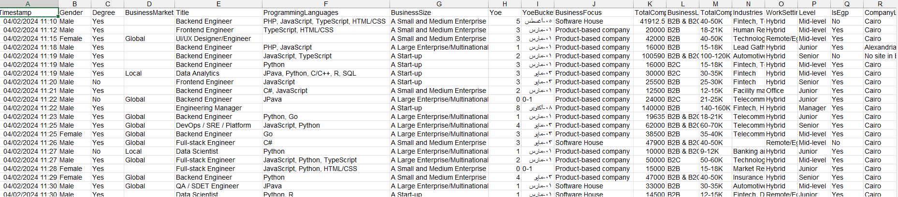
Discover Data

Slide 15
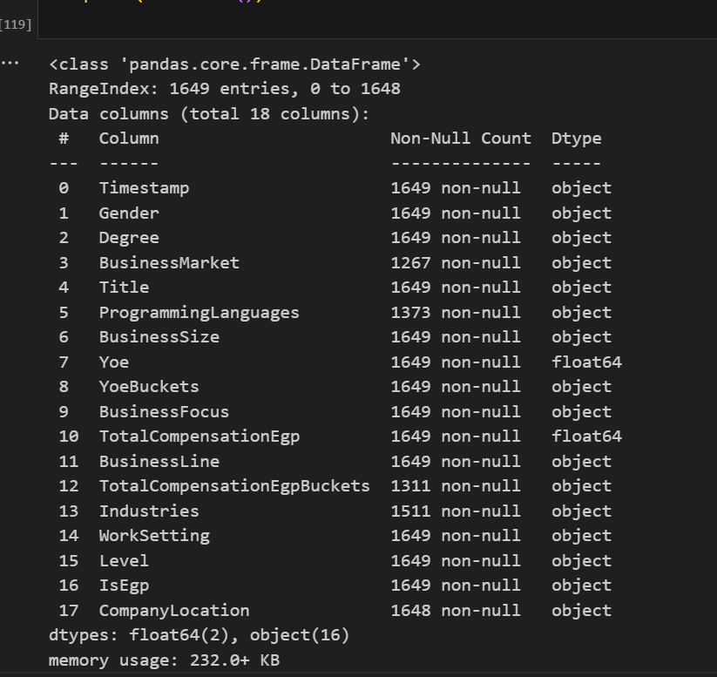
Discover Data

Slide 16
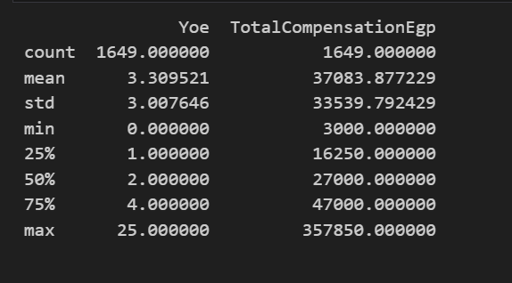
Data Describe

Slide 17
Data Cleaning

Slide 18
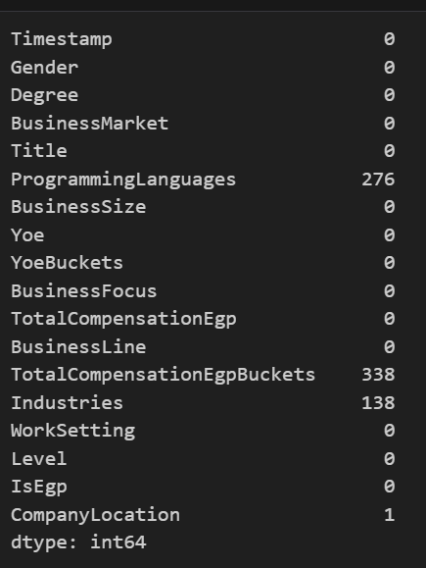
Missing value

Slide 19
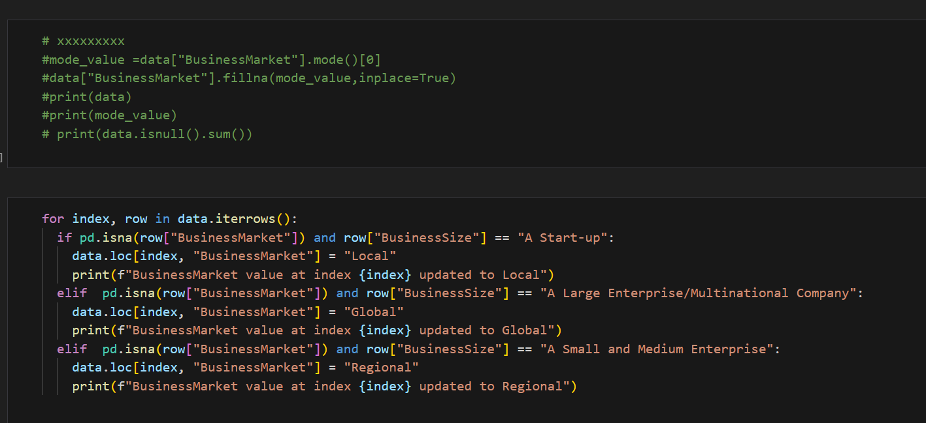
Filling (Business_Market) missing values

Slide 20
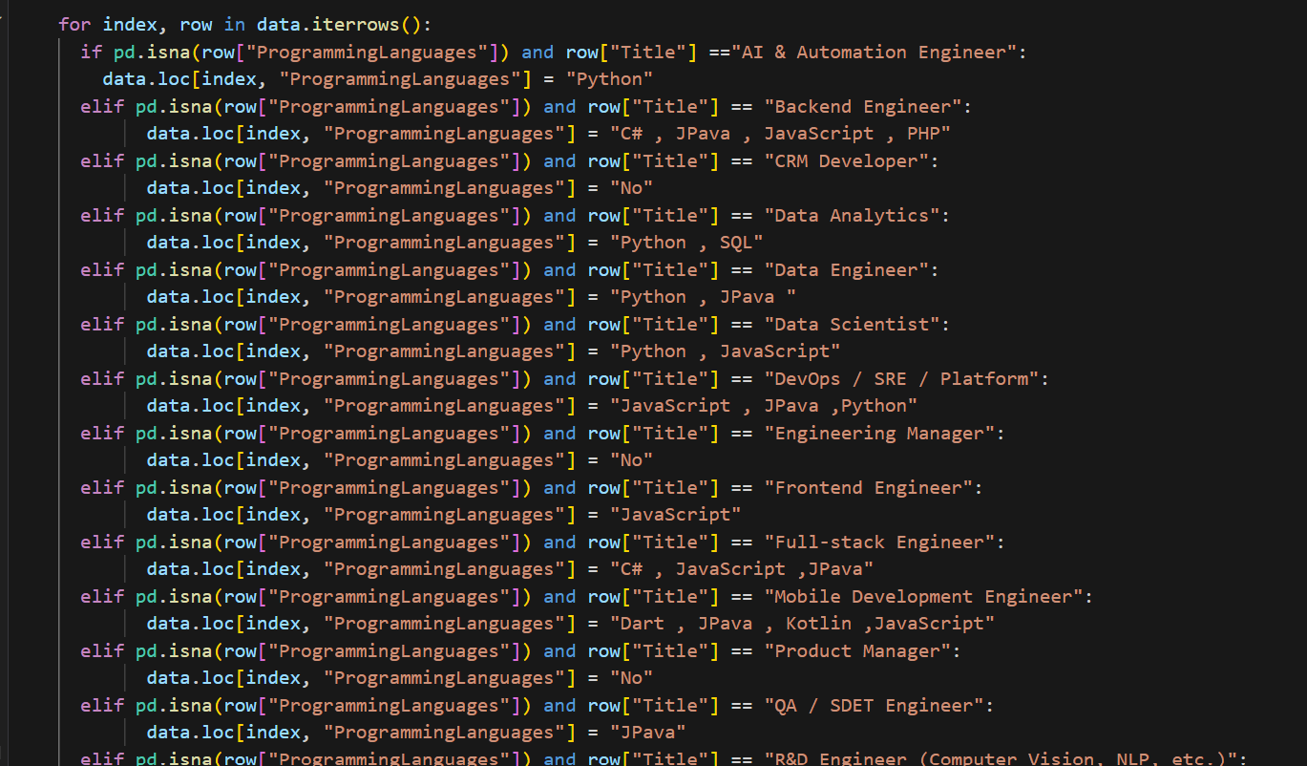
Filling (programming lang) missing values

Slide 21
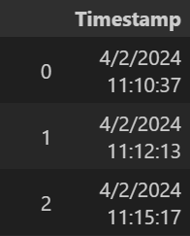
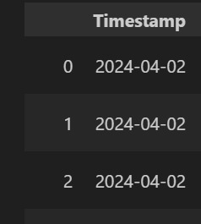
Editing and Delete time

Slide 22
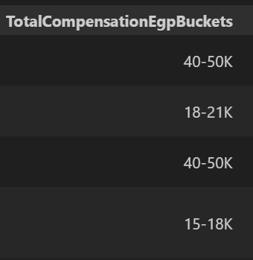
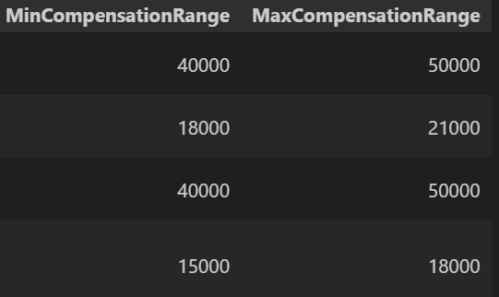
Split column
delete k
multiply *1000

Slide 23
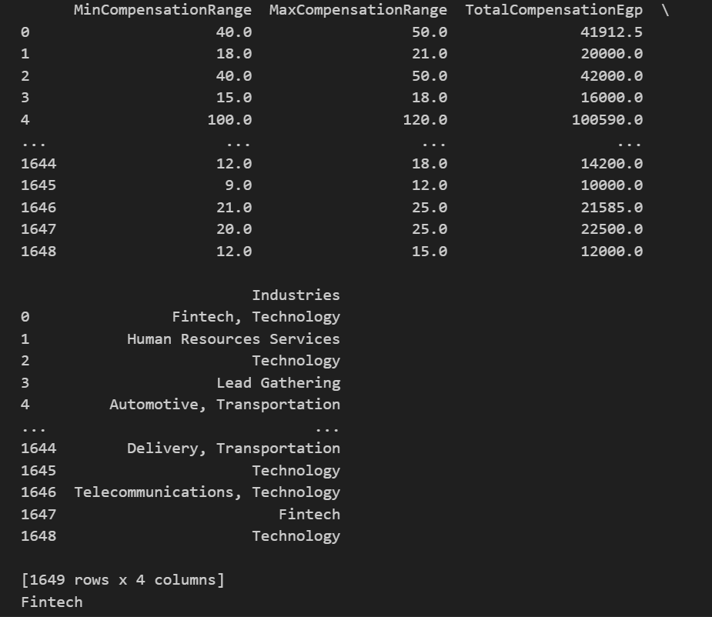
Filling missing value of industry

Slide 24
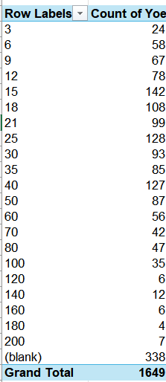
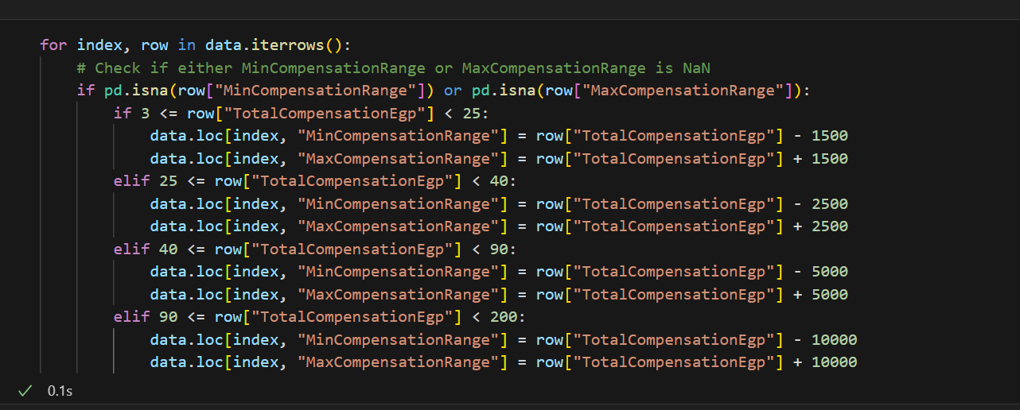
Fill missing value min and max

Slide 25
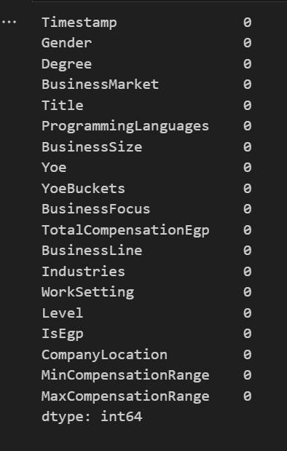
Data is cleaned

Slide 26
Exploratory data Analysis(EDA)

Slide 27
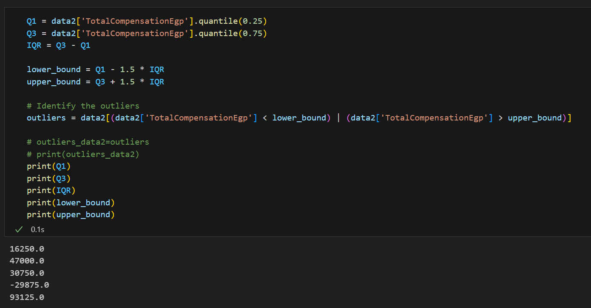
Detecting outliers

Slide 28
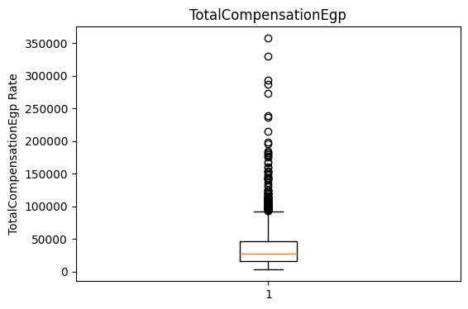
Explore outliers

Slide 29
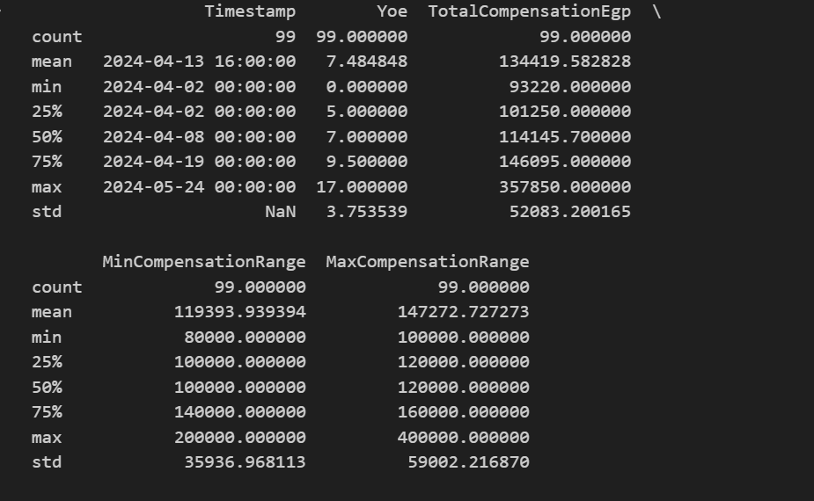
Describe outliers

Slide 30
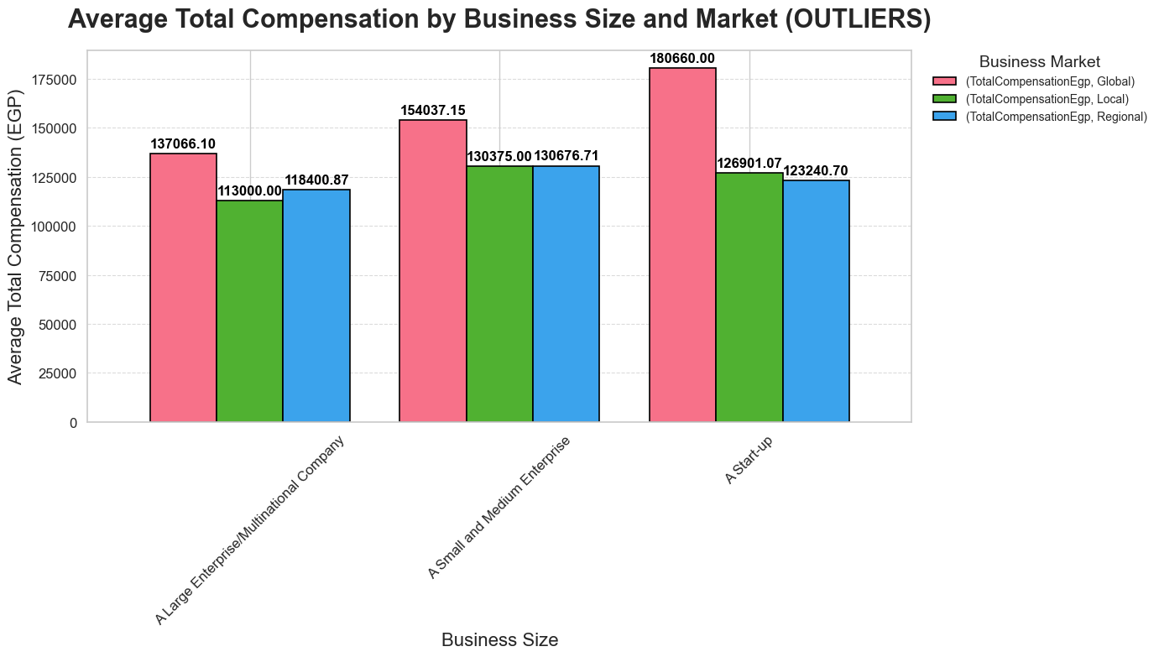
Average Total Compensation by Business Size and Market (OUTLIERS)

Slide 31
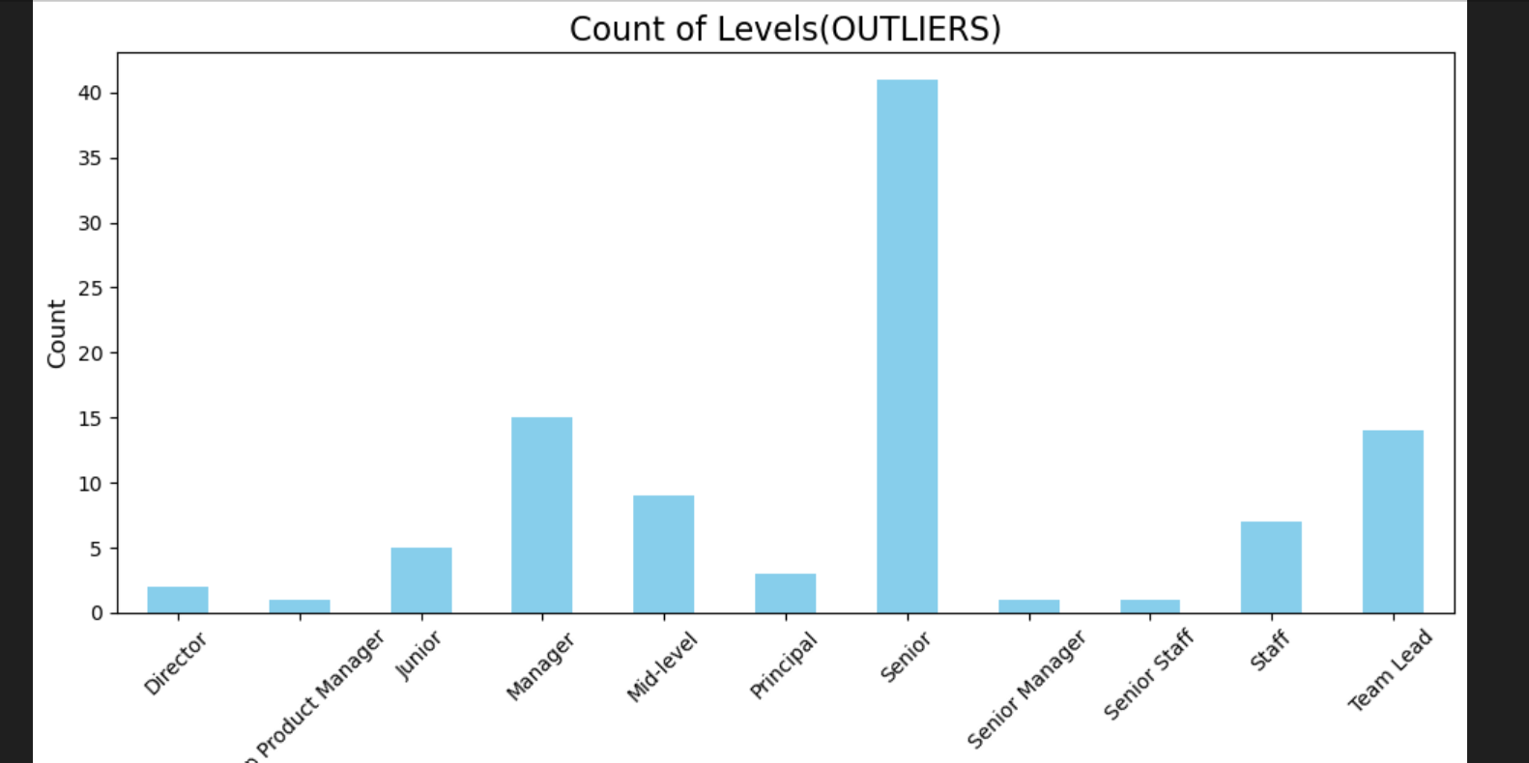
Count of Levels(OUTLIERS)

Slide 32
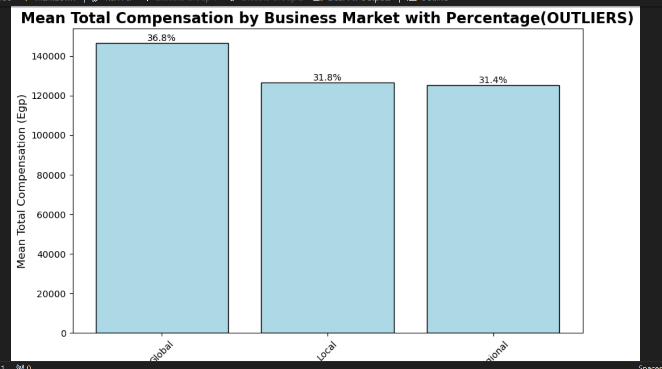
AVG Total Compensation by Business Market with Percentage(OUTLIERS)

Slide 33
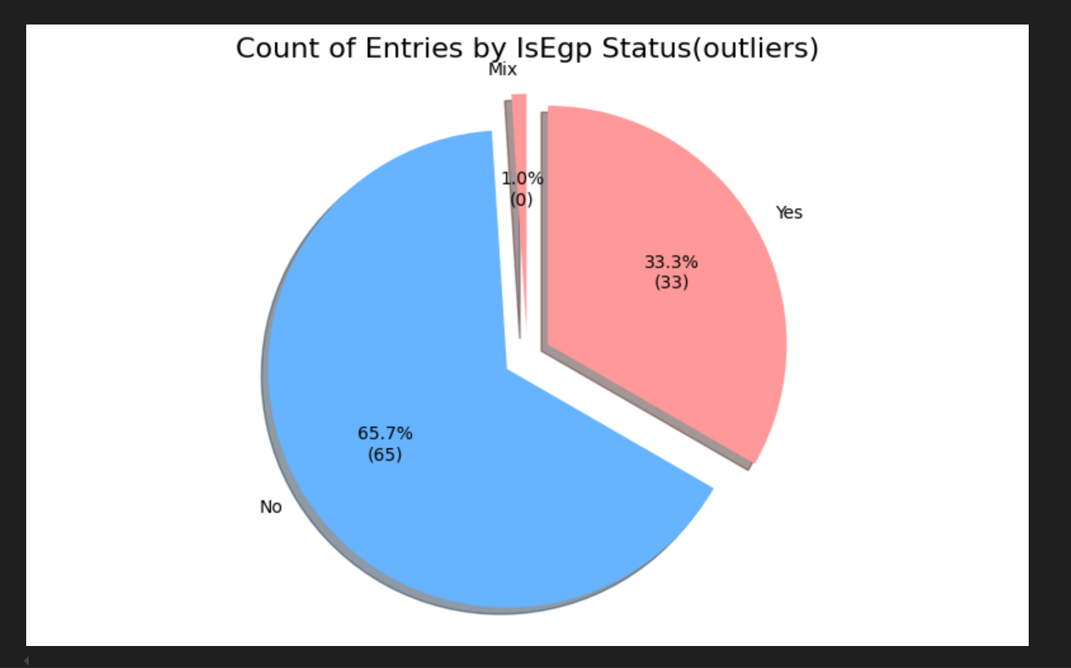
Count of Entries by IsEgp Status(outliers)

Slide 34
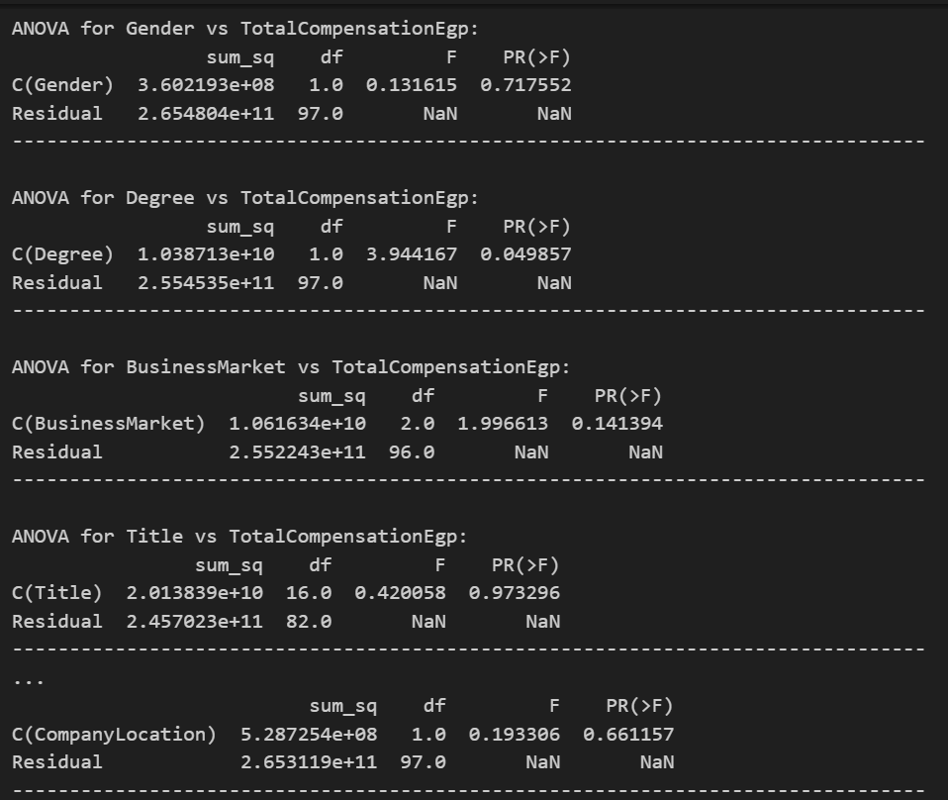
ANOVA OUTLIERS

Slide 35
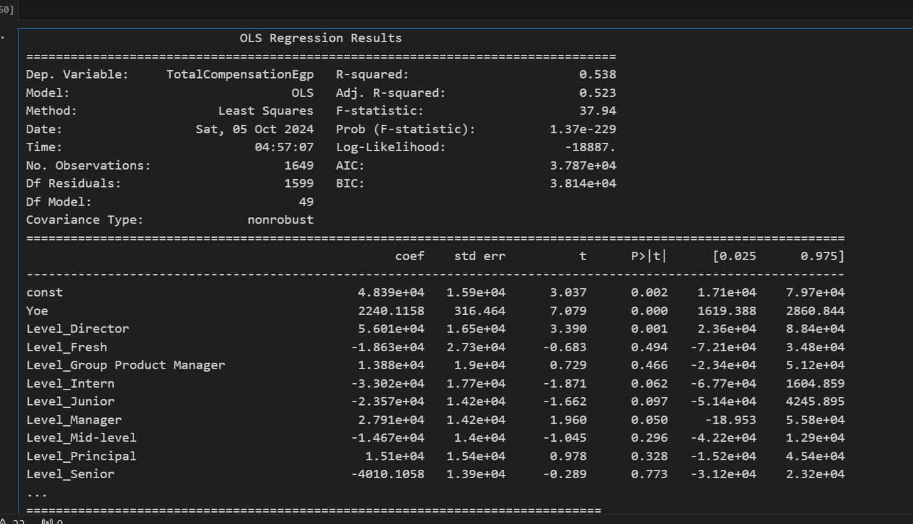
Regression data

Slide 36
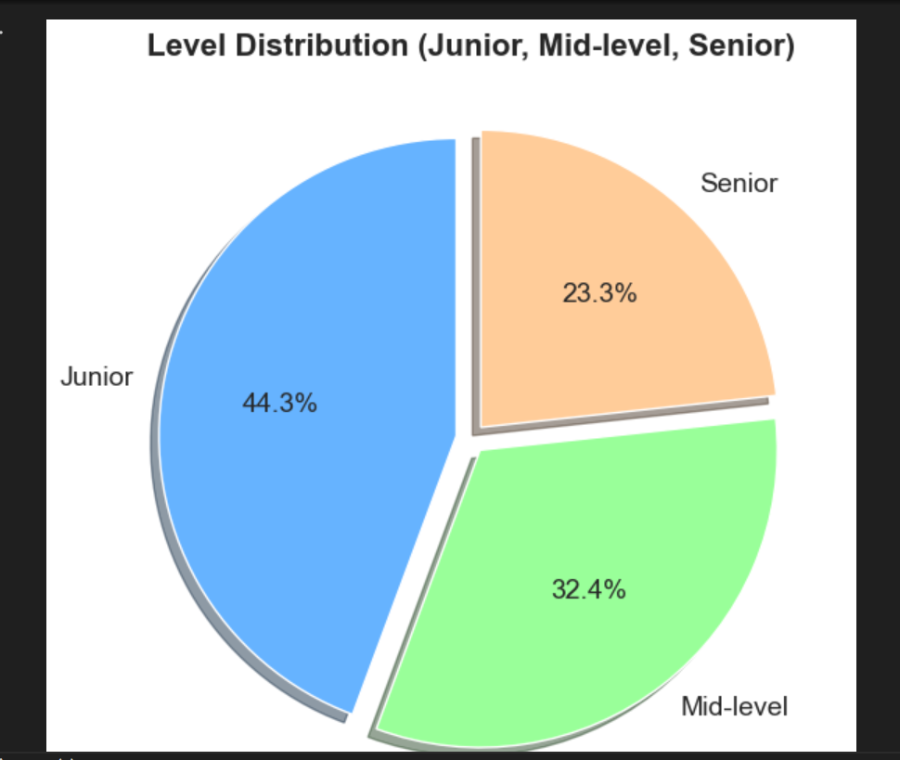
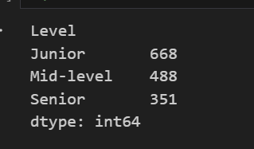
Level Distribution (Junior, Mid-level, Senior) All data

Slide 37
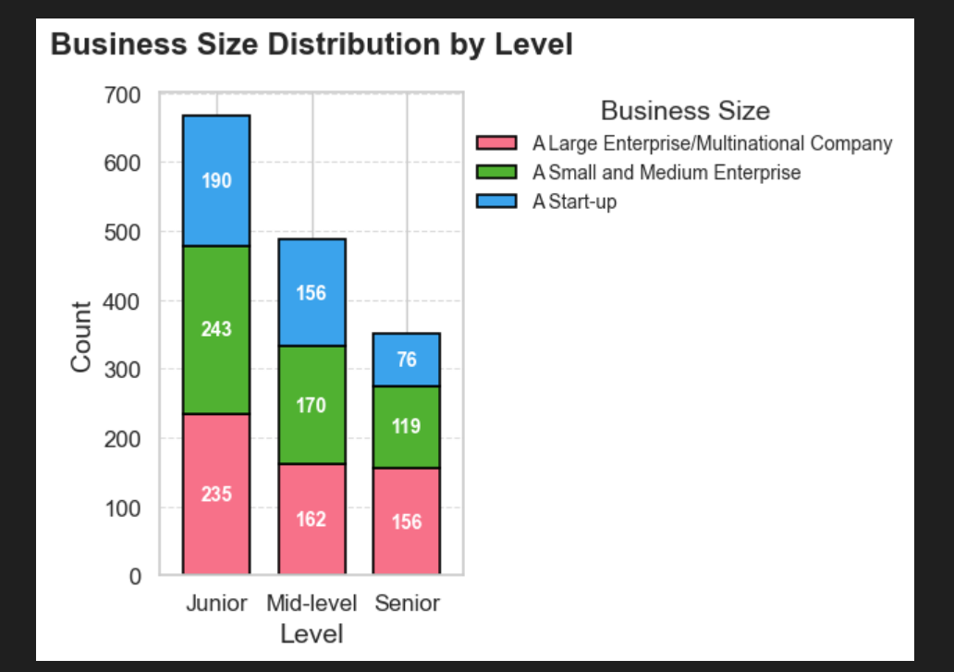
Business Size Distribution by Level

Slide 38
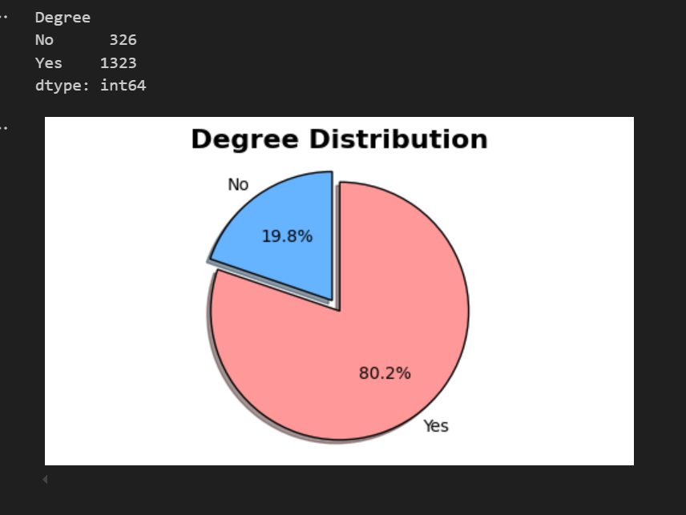
Degree Distribution

Slide 39
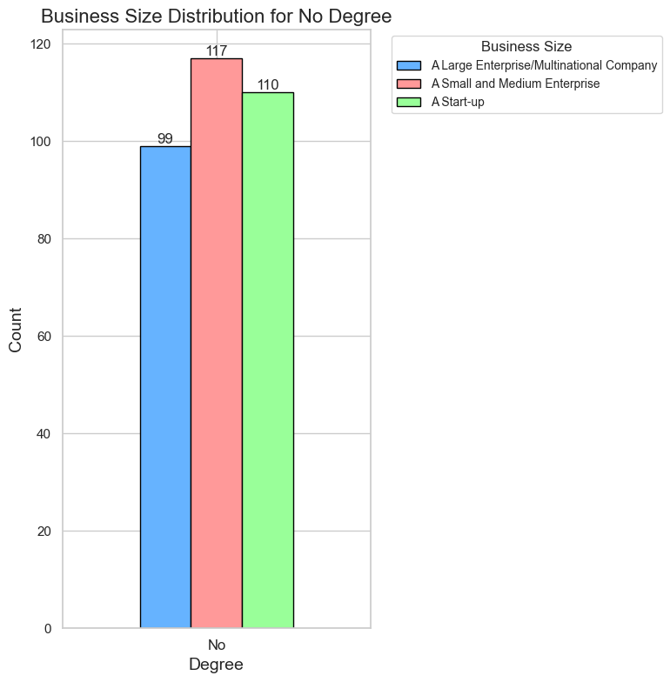
Business Size Distribution for No Degree

Slide 40
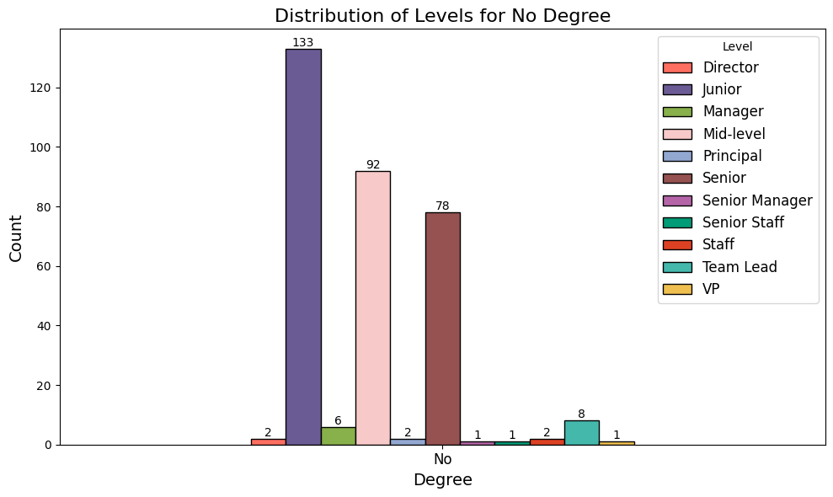
Distribution of Levels for No Degree

Slide 41
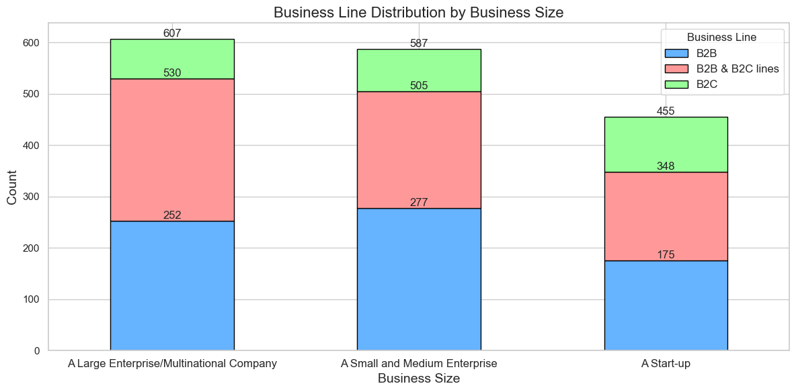
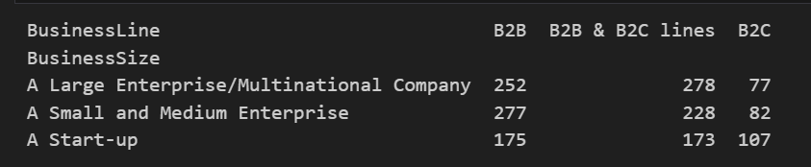
Business Line Distribution by Business Size

Slide 42
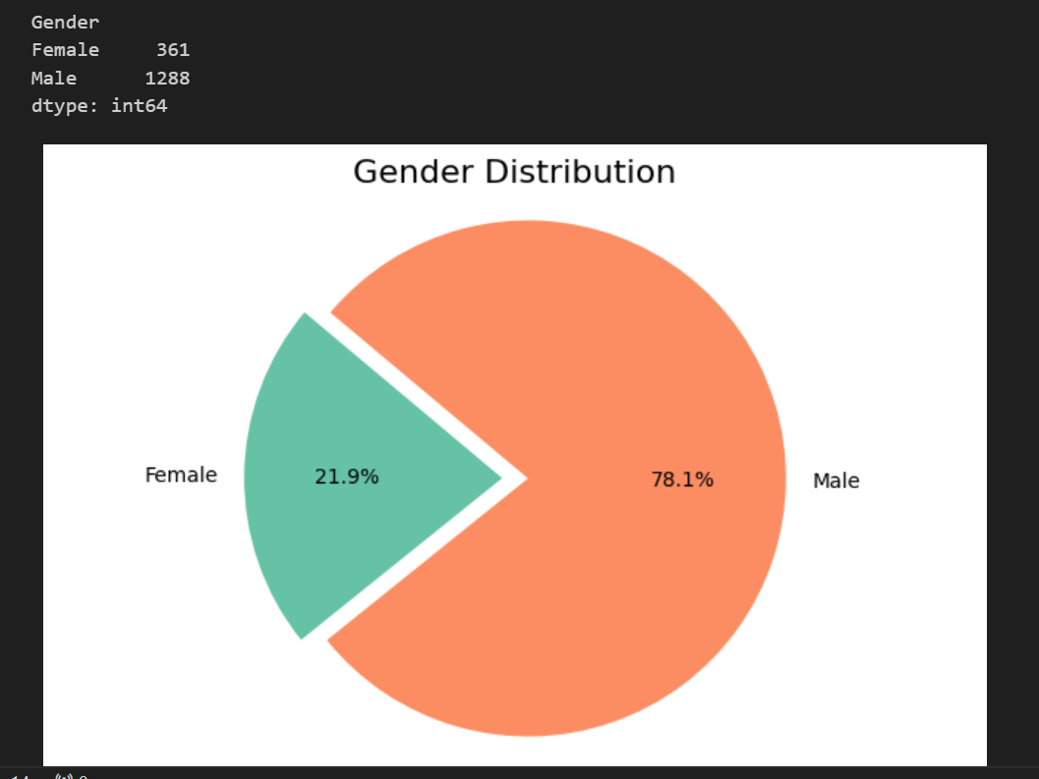
Gender Distribution

Slide 43
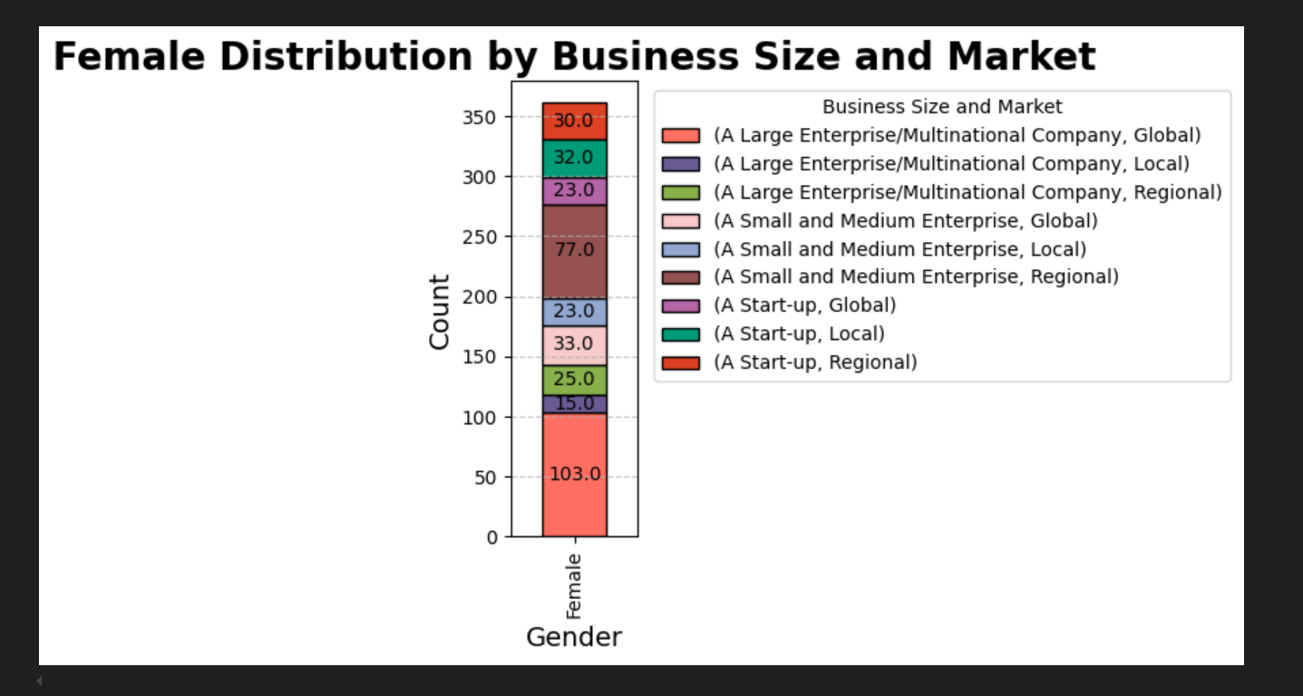
Female Distribution by Business Size and Market

Slide 44
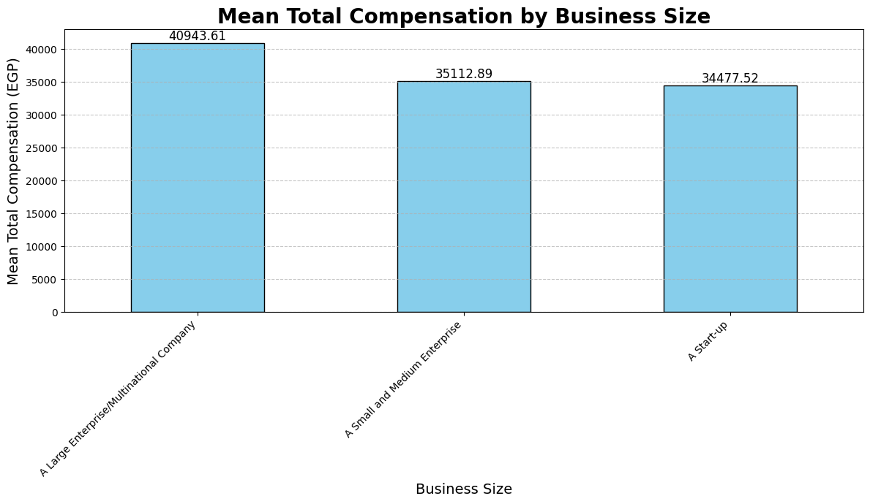
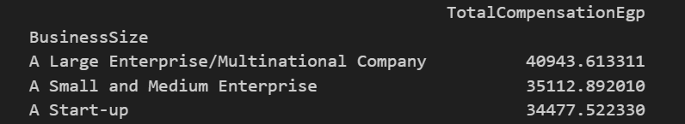
AVG Total Compensation by Business Size

Slide 45
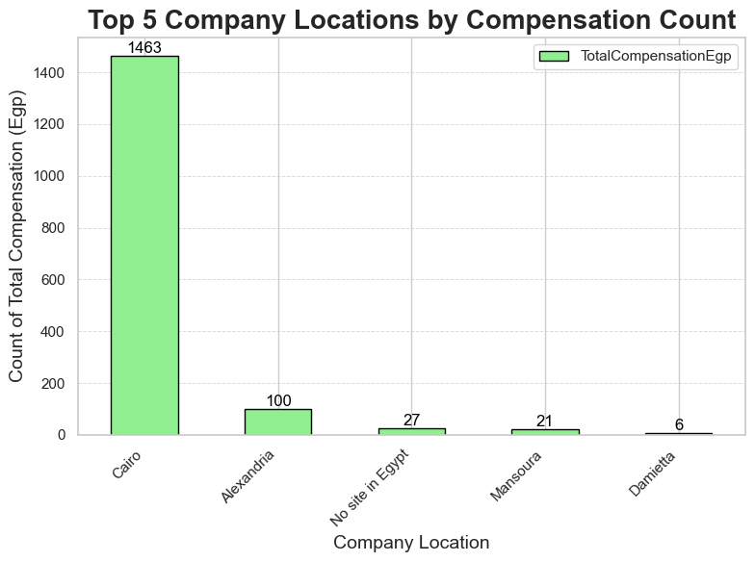
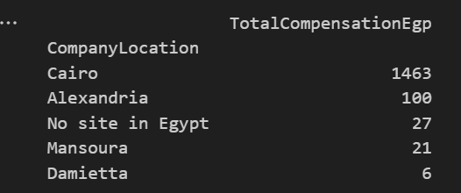
Top 5 Company Locations by Compensation Count

Slide 46
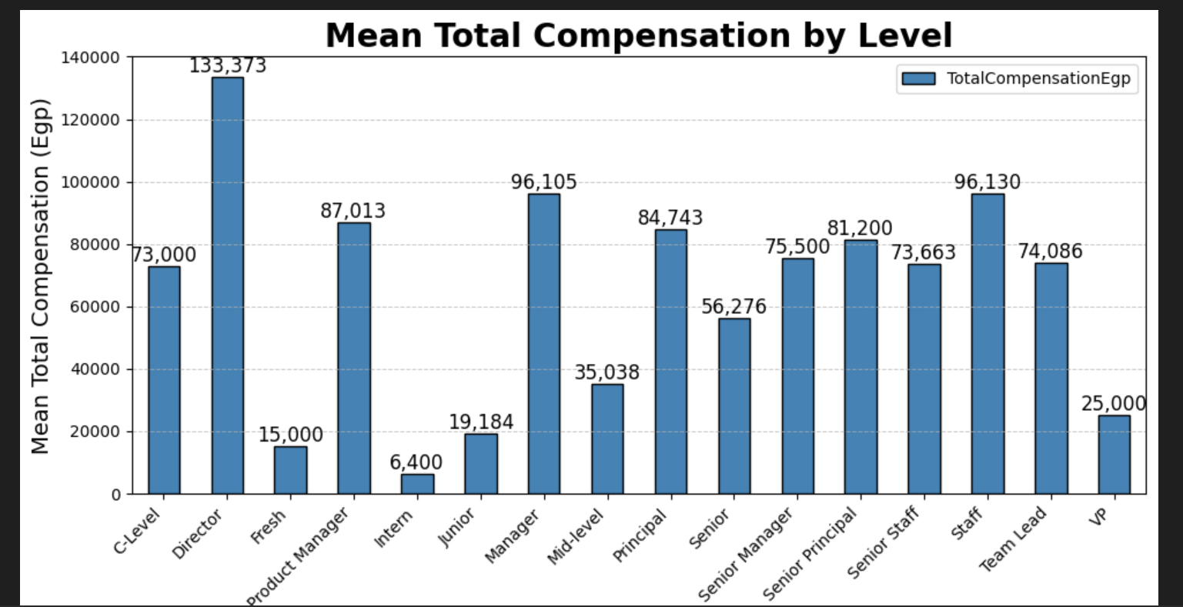
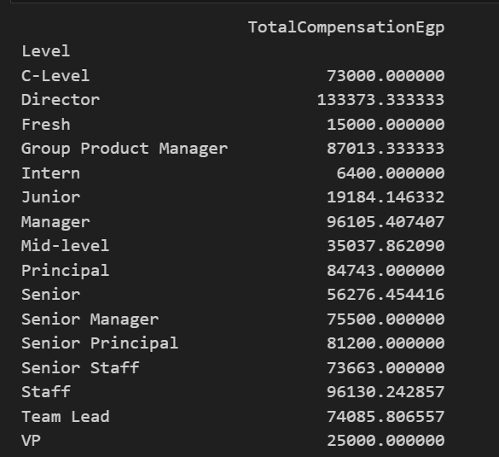
AVG Total Compensation by Level

Slide 47
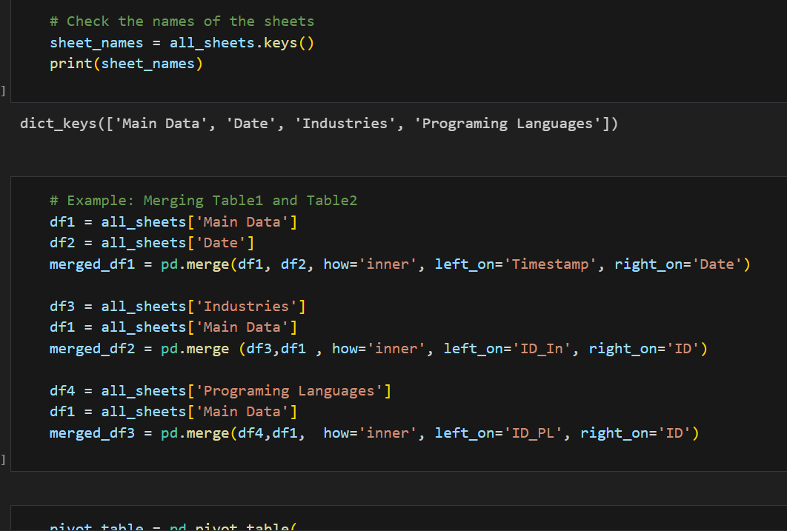
Merge 4 Sheets In Python

Slide 48
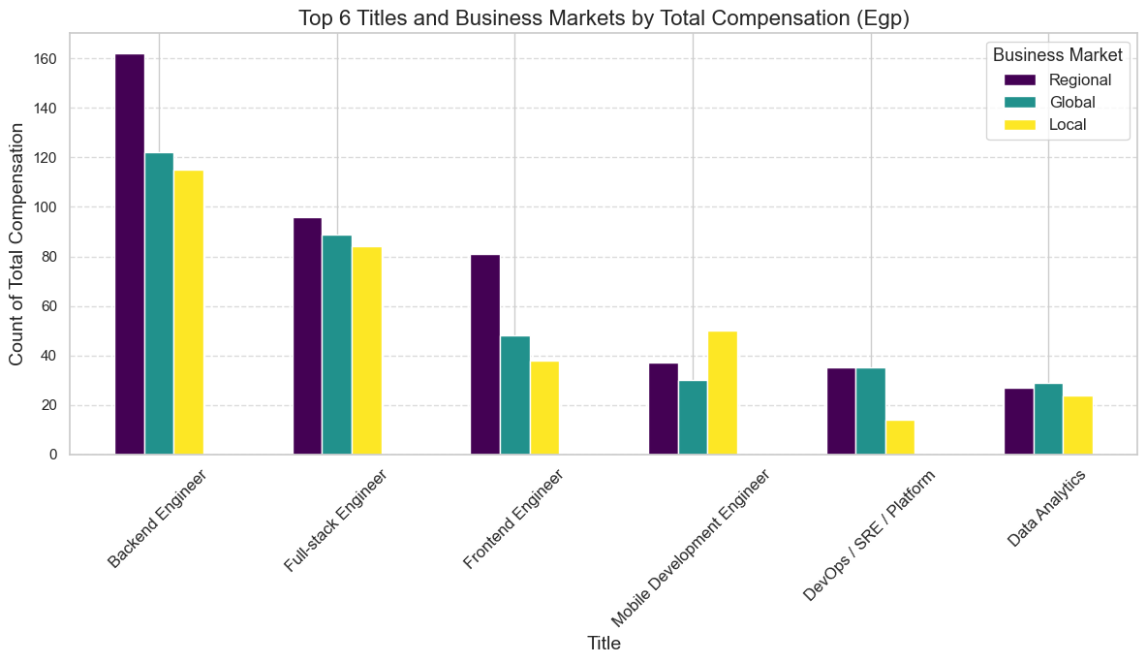
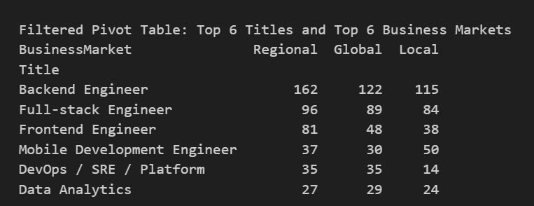
Top 6 Titles and Business Markets by Total Compensation (Egp)

Slide 49
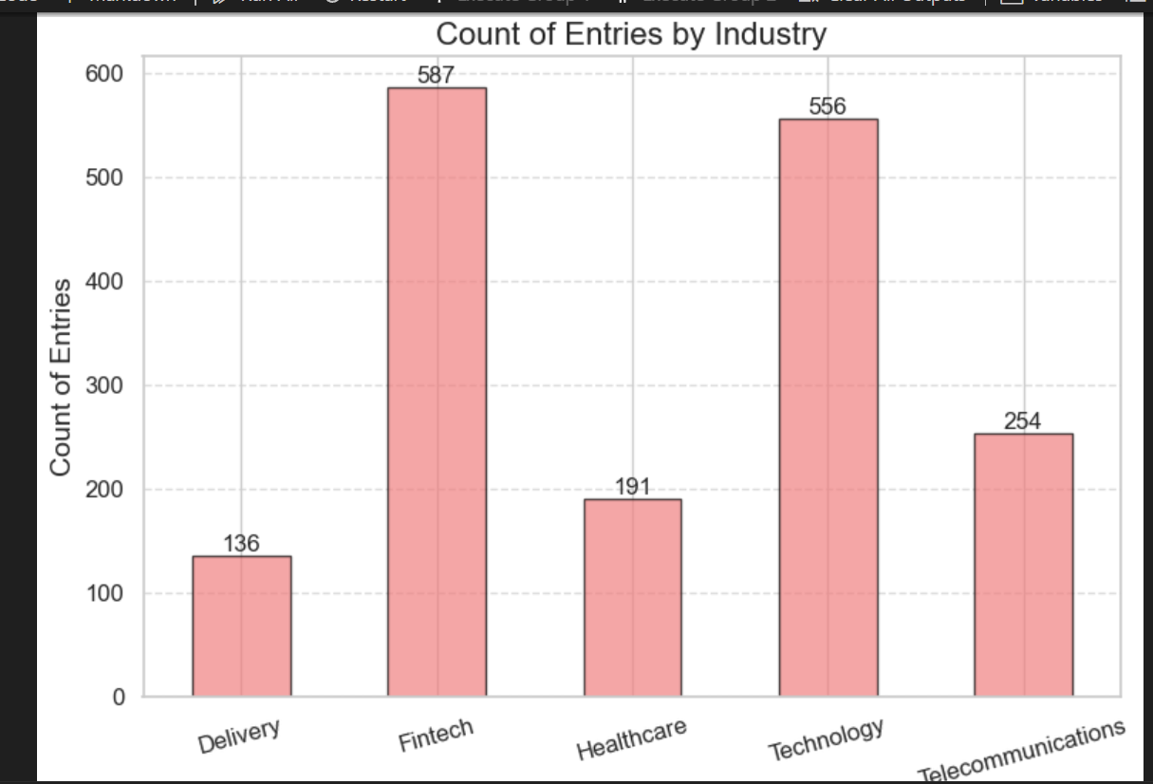
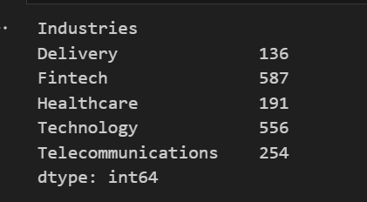
Count of Entries by Industry

Slide 50
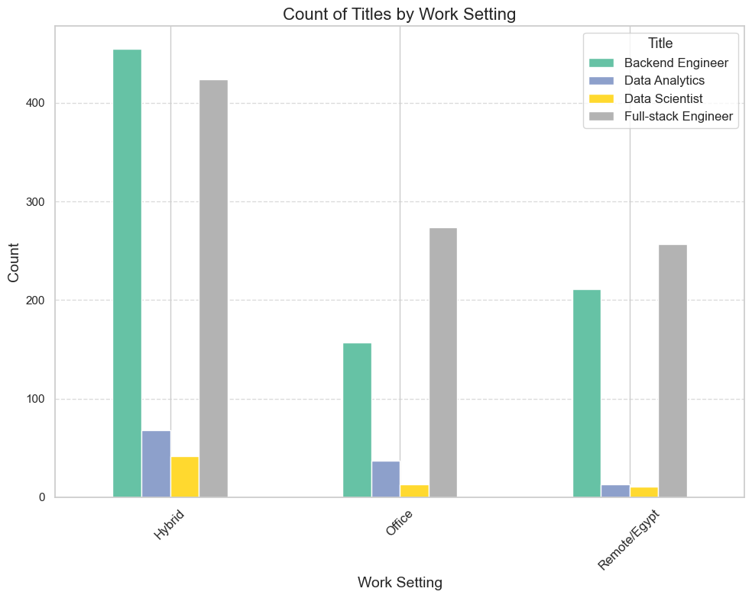
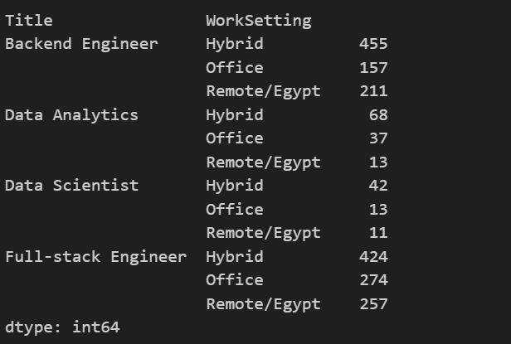
Count of Titles by Work Setting

Slide 51
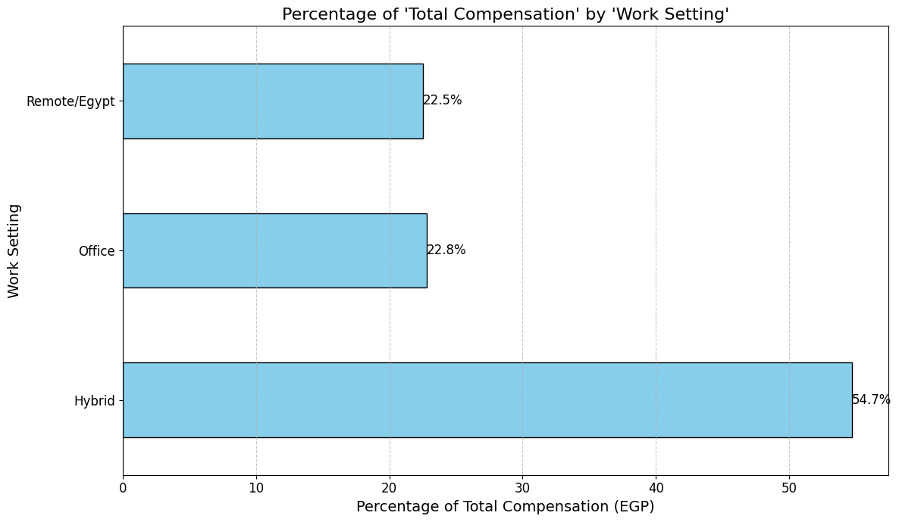
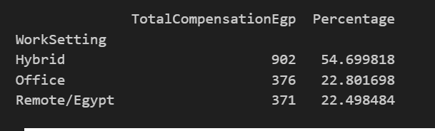
Percentage of 'Total Compensation' by 'Work Setting'

Slide 52
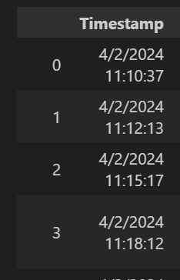
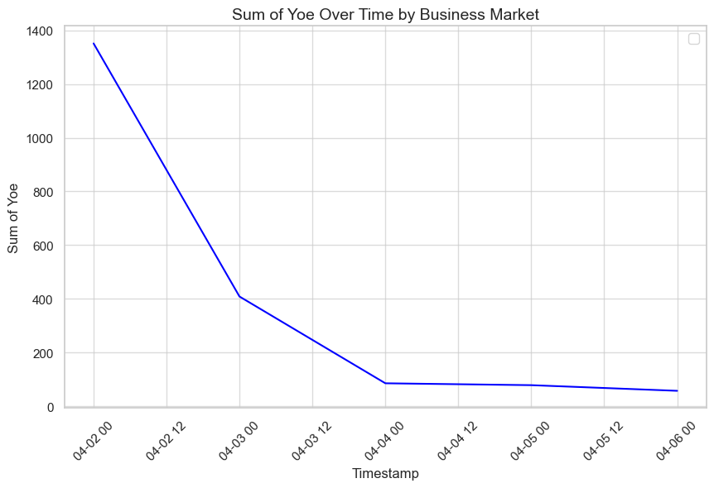
Peak Employment Date

Slide 53


Total Compensation by Business Size and Market

Slide 54

Count of Total Compensation by Business Focus and Business Market

Slide 55

Count by 'BusinessFocus' and 'BusinessLine

Slide 56

Count of Total Compensation by Business Size

Slide 57


Count of ID_PL by Programming Languages(developers)

Slide 58

Top 6 Programming Languages for Full-stack Engineer

Slide 59


Average Compensation Ranges by Level

Slide 60

Average Total Compensation by Years of Experience

Slide 61

Average Total Compensation by Work Setting

Slide 62

Average Total Compensation by Business Size and Market

Slide 63

Cleaning with Microsoft SQL Server

Slide 64


1-Show Duplicate Data

Slide 65

2-Identify and display outliers

Slide 66

3-Exploring Empty Values

Slide 67


4-Normalization (NF-1)

Slide 68


4-Normalization (NF-1)

Slide 69


5-Normalization (NF-2)

Slide 70

5-Normalization (NF-2

Slide 71

6-Create Calendar Table

Slide 72

7-Linking Tables

Slide 73

7-Linking Tables

Slide 74

R Programming language

Slide 75

Detective outliers

Slide 76

count of level outliers

Slide 77

Count of Entries by IsEgp Status (Outliers)

Slide 78

count Total by Business Size and Market (outliers)

Slide 79

Average Total Compensation by Business Size and Market

Slide 80

Business Size Distribution by Level

Slide 81


Degree Distribution

Slide 82
Business Size Distribution for No Degree

Slide 83

Distribution of Levels for No Degree

Slide 84

Business Line Distribution by Business Size

Slide 85

Gender Distribution

Slide 86

Female Distribution by Business Size and Market

Slide 87

AVG Total Compensation by Level

Slide 88

Count total by work setting

Slide 89

AVG total by work setting

Slide 90

Count of Total by Business Focus and Business Line

Slide 91

Count total by business focus and business market

Slide 92
Dashboard EXCEL

Slide 93


Slide 94


Slide 95
Dashboard Tableau

Slide 96


Slide 97


Slide 98


Slide 99


Slide 100


Slide 101


Slide 102
Insights
1 year of experience affects the salary by 2240 Egp
Being working as a director affects the salary by 56,010 Egp
Salary is not Egyptian pound affects the salary by 24,750
Being working in Cairo affects your salary by 6,349

Slide 103
Insights
We are sure that “years of experience” data affects 95% of salary column from range (from 1619.388 to 2860.844 )
Industries , level have significant different on salary
Degree may have slightly impact on salary
Peak Employment date is the first of the month of june
25% people work in fintech industry

Slide 104
Insights
55% people working hybrid(office and remote)
Only 16% get paid in currency rather than Egyptian pound
21% of outliers are working as backend Engineer
67% of the outliers are working in regional and global Companies
Most used language is JavaScript followed by python

Slide 105
conclusion
The provided data analysis suggests that several factors influence salary levels, including years of experience, job title, location, and currency type.
Overall, the analysis highlights the importance of experience, job title, location, and currency type on salary determination and provides insights into employment trends and industry preferences.

Slide 106
Questions?

Slide 107

Thanks

